Slide 1
Conspiracy Theory Game
Student: Charles Quentin Adam

Slide 2
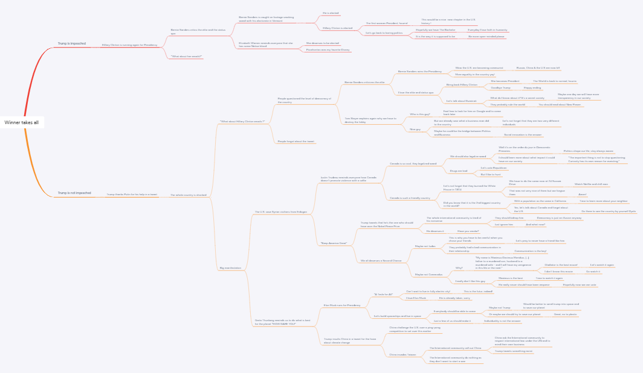
Draft Mind Map

Slide 3
Python essentials covered in the game.
User Input and input Handling – Very first step when entering name and controlling for error.
Strings and its manipulation – Can be seen at all steps in stage 5
Variables – All defined at the beginning e.g. var2_1
User-defined functions – All steps in the game are functions leading to another in a chain.
Conditional statements - are present in each step/each function.
Nested conditionals – found in the start() function
Loops – can be found in the jail() function at the end of the script.
Controlling for errors at every step/every function even the start function.

Slide 4
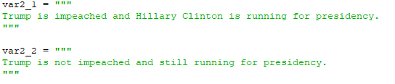
Stage 1

Slide 5
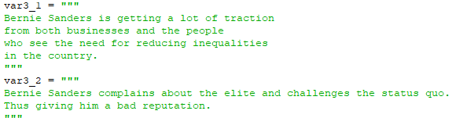
Stage 2_1 if var2_1 is chosen then you have the choice between the two others below.

Slide 6
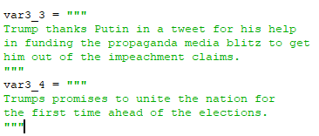
Stage 2_2 same here, if var2_2 is choses you have the choice between var3_3 or var 3_4.

Slide 7
Stage N_n
same

Slide 8
Until we reach Stage5
At those stages, the previous choices are combined with the
Print(f”{varN_n}{…}{varN+1_n+1}”)

Slide 9
A fail() function exists under the name jail() if the player fails.
As well as a function called step_end() if the player “wins”

Slide 10
An Easter egg is present at two place.
You will need to play to unlock it, otherwise you will not know.
Unless you look at the code, but it is more fun playing!

Slide 11
Thank you and have fun playing my Conspiracy Theory Game!

